Slide 1
An Extensible Framework
Module 1

Slide 2
Objectives
Create the developer environment
Core Dynamics 365 developer extensibility features
Where to place business logic in the Dynamics 365 architecture
Platform and data access
Key skills for developers
List of resources
Notes:
Business applications typically model and track connections between various types of business data (people, places, and things). Microsoft Dynamics 365 provides for declarative development of relational business applications with flexible data models and dynamic services. In addition to the declarative application capabilities, business applications built on Dynamics 365 can be extended and integrated with external systems through a rich Software Development Kit (SDK).

Slide 3
xRM – the extensible Platform
Build any application on top of the Dynamics 365 Platform
Customize existing Customer Relationship application
Create new line-of-business application outside of sales, marketing or service areas.
Platform provides data modeling, presentation and security management, events, etc.
Extended Relationship Management
-or-
‘anything’ Relationship Management
Ensures a scalable framework for both enterprise and small customers (on premise/online)
Declarative Design Model
Notes:
Extensibility is provided by an architecture based on abstraction. There is a separation of concerns, where the data, presentation, workflow and security aspects of the application are exposed as a framework, where developers/customerisers can bring in new data, presentation, and business processes on top of the existing structure.
The separation of the data from the UI via a web service layer, allow multiple client types; on premise, online, outlook, etc. The Business application services providing the data abstraction allow for scaling, multi-tenancy, combined with the ability to host online create a flexible open model that can adapt to changing business needs.
Dynamics 365 uses a Declarative Design Model whereby application creation tasks can be achieved from a design rather than a coded perspective, thus form design, security, CRUD actions can be generated just through design.
Developers/customisers can easily create applications based on the framework to extend Dynamics 365, taking advantage of the built in security model, the data abstraction layer, the UI generation pattern, the flexible hosting pattern.

Slide 4
Creating a Developer Environment
A suggested Install
Visual Studio 2015
Dynamics 365 SDK
Fiddler to audit http traffic
Nuget packages for Dynamics 365
Xrm Toolbox (including RibbonWorkbench )
Entity metadata Browser
Unit testing framework – FakeXrmEasy
CRMRestBuilder
SSIS – Kingswaysoft CRM adapter.
Notes:
Whilst the Dynamics 365 SDK has a version of the Visual Studio Developer Toolkit for Visual Studio 2015
Nuget Packages for dynamics 365
Microsoft Dynamics 365 SDK core assemblies
This package contains the official Microsoft.Xrm.Sdk.dll and Microsoft.Crm.Sdk.Proxy.dll assemblies plus tools and has been authored by the Microsoft Dynamics 365 SDK team.
Microsoft Dynamics 365 SDK deployment assembly
This package contains the official Microsoft.Xrm.Sdk.Deployment.dll assembly and has been authored by the Microsoft Dynamics 365 SDK team.

Slide 5
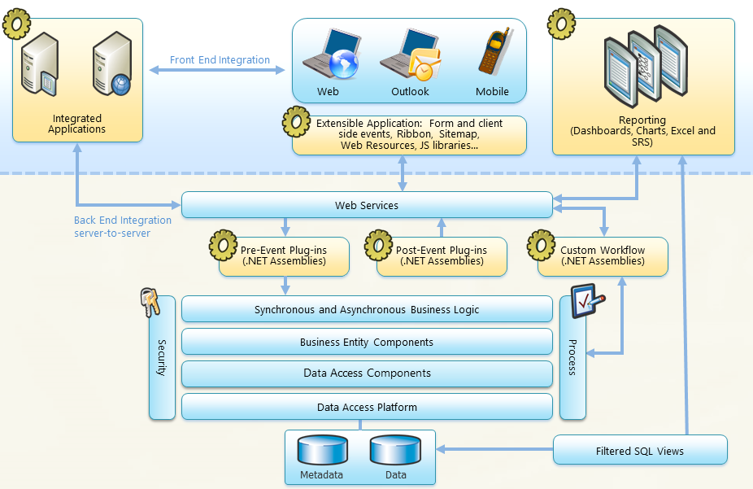
Extensibility Points and Features
Notes:
Blue sections are areas for customisation, some customisations will have general scope like plugins and entity wide business rules, whilst some specifications have local scope like changing a specific role based form, or writing process logic in a new consumer application.
Some customisations need to be developer generated such as Plugins, some can be defined by Dynamics 365 users such as WorkFlows and Business Rules
Customisations in business logic may need to be immediate to the user such as Java Script, Business Rules and Synchronous Plugins or WorkFlows, whilst others can take place in the background such as Asynchronous Plugins and WorkFlows.
All customisations bar external consumer applications, can be part of a solution used to deploy or snapshot these customisations.

Slide 6
Navigation – sitemap and command bars
New tabs
Enable/Disable buttons
Hide/Display buttons
Navigate to external URLs or Web Resources
Run WebResource scripts
Future – new Unified Interface and App Designer
Notes:
The sitemap allows for the control of system wide navigation, and grouping of options for organising work and controlling display for different roles. The command bars allow for the display of commands to navigate to different entities, web resources or run scripts from the context of a particular entity.
These 2 structures can be exported out from Dynamics 365 for external modifications in the form of Customisations.xml contained within a solution. The Customizations.xml can be modified in a text editor, and reimported as a solution.zip. There are also several tools that allow the modification of the Sitemap and Command Bar through a visual editor, such as the XRM ToolBox sitemap editor from codeplex.

Slide 7
Entity Forms
Enhanced flexibility specific to role, function, desktop, mobile
Form and field level events respond immediately
Script Libraries hold reusable JavaScript that provides rich programming features
Interaction with form elements in a supported manner only using Xrm.Page, rather than document.getElementById
Business Rules, single and multi Form or Entity specific
Future – Xrm.Webapi – use REST API
Xrm.Page deprecated
Notes:
Forms can be specific to a particular role, or device, or context, so which fields are displayed, what Business Rules or Javascript applied can be differentiated for each.
Form and field events can be used to validate and format data, hide and display controls, and this can be achieved using Business Rules or JavaScript. The advantage of JavaScript is that it can be as complex as needed, whilst Business Rules limited in their complexity, can be applied at an entity (server) level (not just restricted to the form UI).
The use of auto save can facilitate users changes being saved before they navigate away from a record. However, this can be manipulated to stop saving data based on validation rules
Javascript libraries can call external services through JQuery Ajax or the XmlHttpRequest, this can be the OrganizationService or the oData Service, or any other external service, so the UI can be refreshed with data without submitting changes back to the web server layer. Javascript libraries are held first as web resources of a solution, then referenced by the form. As such they can be easily exported, as well as reused across forms.

Slide 8
Notes:
Business Rules allow for validation that can be created declaratively and reused across all the entities of a form if desired, but do allow for the animation of form elements.
Microsoft does not support the access and manipulation of the Form elements through the Html DOM, eg, document.getElementById(“address1_city”).value=“London”. Whilst this may have worked in previous versions of CRM, the use of composite fields eg. City is part of the composite address, plus the need to abstract the field from the physical implementation within the Html mean Xrm.Page.getAttribute(“address1_city”). setValue(“London”) should be used

Slide 9
Processes
Workflows
Dialogs
Differences between Workflows and Dialogs
No interaction vs. Prompt and Response
Custom Workflow Activities (On-Premise or On-Line)
Declarative Workflows (On-Premise)
Business Process Flow
Actions
Notes:
Workflows are designed declaratively, specifying an entity and a trigger (record change or on demand from user). They specify a sequence of commands to execute such as assign field value, create record or email to perform in response to the trigger. The commands can be run conditionally but without any user interaction. The choice of simple commands available through the designer can be extended by the creation of Custom Workflow Activities. These are developer compiled .Net assemblies, with the full flexibility of the .Net languages, to access external resources and perform actions within Dynamics 365 or other systems. Once registered with the system, Custom Workflow Activities can be added as an action through the WorkFlow designer.
Dialogs are wizard like helpers to guide the user in data entry, they provide prompts and answers, which can be fixed or lookup values from the system.
Workflows can run on-premise or online but never offline as no asynchronous service on the outlook client. Even a Real Time workflow can not run offline. Dialogs can be run online , on-premise NOT offline.
WorkFlows generally run Asynchronously, but since CRM 2015 can run real time too, so could be used for validation. Dialogs run Synchronously.

Slide 10
Notes:
Actions like WorkFlows are created in the Process designer and are a sequence of commands, but differ in that they can accept and return parameters. They do not execute from a system trigger or on-demand by the user. Instead, they are run in code, and as such, are a hybrid of Dynamics 365 user design, and developer implementation.
https://technet.microsoft.com/en-us/library/dn949331.aspx
Business Process Flows are a visualization of the progress of an entity through a specified business process, such as the lead to opportunity process.. They are created in a designer where the passage from one stage to another in the process is defined through the presence of certain data, but not the quality of the data, eg. There is no validation, (use Business Rules instead), just a mechanism to gather the business decision metrics in a sequenced way.

Slide 11
Plugins
.NET Assemblies
Can be triggered by multiple events
Can run at different stages of the Request processing pipeline
Windows Azure
On-Premise and Online
Offline and online (Microsoft Dynamics CRM Client for Microsoft Office Outlook)
Future – Outlook plugins deprecated
Notes:
Plugins are .NET Assemblies, so have greater programmatic complexity than declaratively designed processes (WorkFlow, Actions) They can run script that accesses server side resources (although somewhat restricted if running in isolation/partial trust).
Like processes they can be triggered off multiple entity events (Create, Update, Delete, Insert as well as Retrieve, and RetrieveMultiple). They can run at different stages of the request response pipeline, meaning that a plugin could fire before a change occurred to the CRM database, stopping invalid entry, or a plugin could fire after a change was committed to the database, so that other applications could be informed of calculated field values created.
Plugins can run On-Premise and Online too ( although with the restriction of sandbox isolation). They can be deployed with the plugin registration tool, and as part of a solution, and can be Offline (outlook client) and online.
They can be deployed to database (so copied from one server to another in cluster) or web server
If offline can only use offline user – no impersonation, whilst other plugins can run under the actual user or impersonate another user in the case of accessing restricted resources
Plugins can be synchronous or asynchronous, so that long running operations can be run without blocking the UI. Typically synchronous operations should be as short as possible, although both asynchronous and synchronous plugin execution has a 2 minute timeout. Plugins are covered in module

Slide 12
Web Service access to the data layer
No direct access to the SQL database tables
WCF Endpoints
Discovery Web Service – endpoints to other services
Organization Service – CRUD and application functionality
CRM datatypes match standard .NET Types in most cases
WebAPI (Crm 2016) – REST and application level functions – to eventually replace WCF endpoints
Notes:
No direct access to the SQL database tables is supported, all interaction from the UI is through a web services layer or if on-premise, optionally through Filtered Views.
The web services are accessed by WCF Endpoints, that replace the previous CRM .asmx services endpoints. The web service layer exposes the data as standard .NET Types in most cases, allowing for easy consumption. The behaviours exposed by the services are described by WSDL, and this is static and the same for all organizations. So unlike traditional development of a web service client in .Net where a Web Reference is made to generate a consumer side service proxy, the SDK provides service proxy classes.
The Discovery Web Service allows for the resolution of which organisations are present on an installation, and how to access the organization service end point, the WebApi (Odata) Endpoint and the Web UI endpoint.
The Organization Web Service allows for the execution of all CRUD operations and all the business operations available through the UI (assign records, set user roles, etc.)
The oData Web Service that provides a RESTful interface to perform CRUD operations from JavaScript and Silverlight clients. Also assign and share commands can be sent too
The WebAPI endpoint provides a RESTfull interface to all the CRUD operations and the application level functions too.
The Deployment Web Service is used as a programmatic alternative to the deployment manager, allowing the creation of organizations and transfer of settings in a multi-tenancy hosted environment

Slide 13
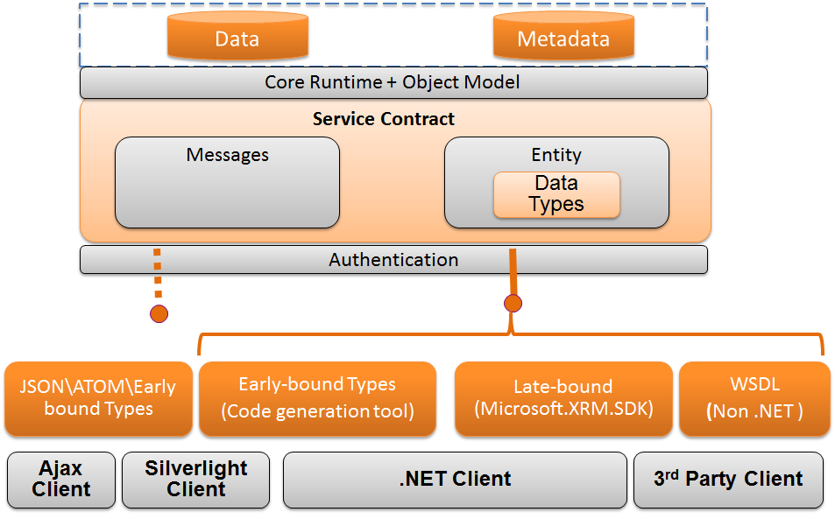
Accessing the Data Tier – through web service calls
Notes:
Access to the Data Tier via the web services interface varies between the consumer type, and the data operations required.
JavaScript within web resources can use the oData Service receiving data in JSON format.
.Net Clients can use the Dynamics 365 SDK querying classes such as QueryExpression, FetchExpression, QueryByAttribute or define early bound types to match the Dynamics 365 data schema via CrmSvcUtil.exe to query the data tier. CRUD operations can also be performed using the SDK’s OrganizationService proxy class and its Execute or Create, Update and Delete methods. The Web Service interface to the Dynamics 365 system also means that any external application could make access to the web services by processing the WSDL (Web Service Description Language). Web Service calls are used throughout the course.

Slide 14
Accessing the data tier
Data Entity Components
Entity Metadata
Dynamic Schema
Data Access Components
QueryExpression
QueryByAttribute
LINQ
OData
Web API
FetchXML
Notes:
The physical storage of the data in the SQL database is abstracted through a metadata layer, for example the physical SQL table accountbase is accessed through the logical entity account. All interaction with the database occurs through the web services layer (except Filtered Views used for SQL reports)
FetchXML is Native to the application, and can be generated for development purposes through the Advanced Find, but can be used in code or for SQL Reporting.
Other data access APIs provide different features:
LINQ allows early bound types to provide compile time assurance, and the use of LINQ expressions that provide a widely accepted technique to query data common across the .Net environment.
The SDK provided QueryExpression and QueryByAttribute classes allow a granular separation of the components of a data query, the field selection, the field order, the predicate, the linking to other entities etc. These query techniques can be called from any .Net consumer application.
oData provides a mechanism to query from JavaScript and Silverlight, using a URL to the oData service to specify the query on a DataSet using similar terms to TSQL, $select ,$filter, $skip, $top.
Not all the data techniques are read/write eg. QueryExpression creates a read only result. Only FetchXml and FilteredViews have aggregate functions.
When inserting / updating records through the SDK APIs, and not through the UI, various form level restrictions can be bypassed, such that an Contact record could be created with no lastname value, but once opened in a Dynamics 365 form this record could not be saved as lastname is business required; but not required at the database level.
WebAPI is the future. Use CRMRestBuilder to design queries.

Slide 15
Web Resources
Benefits
Stored as Microsoft Dynamics CRM solution components
Offline access
Types
JScript
HTML Web Page
Others
Use of ASP.NET
Notes:
The Web Resources are the components for customising sitemaps, command bars, forms, and dashboards. They are contained by Solutions, and as such can be easily exported and imported into other Dynamics 365 systems, or used as a snapshot of the resources at a particular time for auditing purposes. .Net web forms (.aspx) are not allowed as Web Resources.

Slide 16
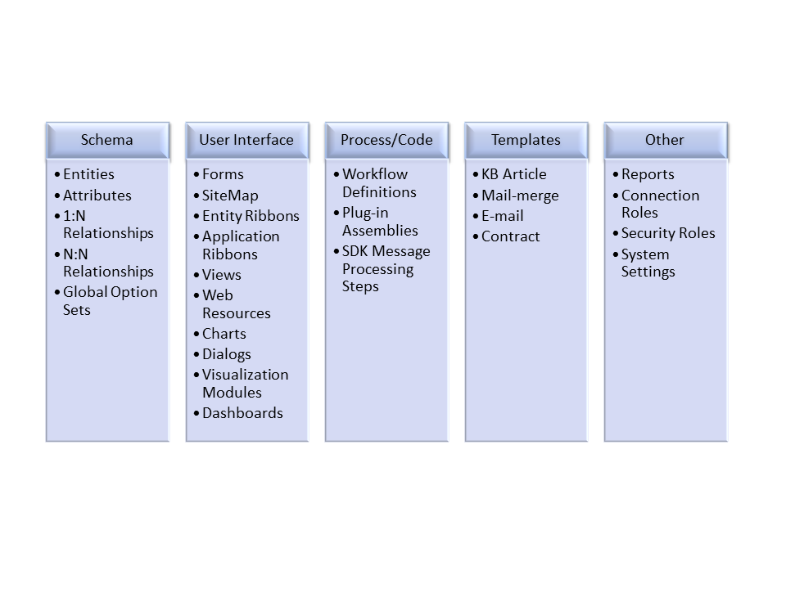
Solutions
Definition
Benefits
Components
Managed
Unmanaged
Notes:
Solutions are the deployment packages of Dynamics 365, they can be exported and imported from one system to another. They can contain new entities or changes to existing ones, new forms or modifications to existing ones, new web resources, UI or process components etc.
Solutions can be Managed or Un-Managed. Managed solutions allow content to be exported from development to production, in such a way that the components of the solution can not be removed or modified ( if their managed properties have been set accordingly). This means a managed solution could be thought of as an all or nothing package.
Unmanaged solutions are useful for exporting content from developer to developer, allowing the recipient to modify, delete, individual items, see the design of processes. The export of an unmanaged solution is imperative when exporting the sitemap and command bar in the customizations.xml as this needs to be modified outside of Dynamics 365 before importing again.
TIP: even if working with managed solutions – export as unmanaged too, so can modify or recover from lost broken images or other resources.
Solutions are used throughout the modules of this course.
Note: Solutions allow the deployment of the metadata, but not the data, eg. A new entity BankAccount can be deployed to another Dynamics 365 system using a solution, but not the data records. To deploy the records, an export to csv, Excel could be an option, or use the solution manager.

Slide 17
Visualisations
Dashboards
Microsoft Office Excel
Web Resources
Web Page HTML
Data (XML)
SQL Reporting Services
Notes:
The CRM customisations, and reporting courses cover the other kinds of visualizations. Dashboards allow an aggregation of data in one view, consolidating views of Dynamics 365 data, Charts, Reports or Iframes linked to web resources or showing external web content. Many CRM contexts, views, charts, advanced find can have the related data saved in Excel format for further analysis.

Slide 18
Resources
Dynamics 365 SDK
APIs for accessing the Organization, oData, Discovery and Deployment Services
Sample code for C#, JavaScript, PowerShell and VB
Tools such as the Visual Studio Developer Toolkit, Plugin Registration, MetaData Browser, Package Deployer, Configuration Manager
XSD Schemas to support writing xml
Codeplex (download Ribbon Editor, XrmToolbox)
Nuget packages
Microsoft.CrmSdk.CoreAssemblies
Microsoft.CrmSdk.Workflow
Microsoft.CrmSdk.XrmTooling.PluginRegistrationTool
Notes:
Blogs
https://community.dynamics.com/crm/default.aspx
https://dynamicscrmgirl.wordpress.com/
https://crmbusiness.wordpress.com/

Slide 19
Lab Module 1A
Setting up the developer environment

Slide 20
Summary
Describe how Microsoft Dynamics 365 is designed to be extended
Recognize the core Microsoft Dynamics 365 developer extensibility features
Explain how "business logic" is incorporated into Microsoft Dynamics 365
Review the overview for how entities are structured and defined within the xRM Framework
Examine how data access is handled with the application
Recognize the skills developers will use to extend Microsoft Dynamics 365
Identify the resources that are available to support developers

